Slide 1
Post-War Prosperity
Canada in the 1920s

Slide 2
After World War One…
When the First World War ended in 1918, many Canadians hoped life would return to normal.
However, during WW1, most of the economy had become a wartime economy
During the war manufacturing revolved around the war effort: food, weapons and ammunition.

Slide 3
Canada: Post-War Economy
When the war ended, Europe’s demand for Canadian goods fell, creating a temporary slump in the Canadian economy.
This was at its worst in the Maritimes and the Prairies because the sales of wheat and fish declined.

Slide 4
The cost of goods and services were high after the war because they were scarce.
* Scarce: having very little of something; hard to find.

Slide 5
When something is scarce, it is expensive.
Examples from today…
Wages did not rise with high prices and returning soldiers had difficulty finding work.

Slide 6
Prosperity For Some…
1923 → Central Canada, British Columbia and the Prairies began to recover from the economic slump.

Slide 7
Agricultural production increased because wheat was in huge demand.
Mining activity in British Columbia, Manitoba and Central Canada increased.
Trade with the United States increased.
Branch plants of United States companies were built in Canada to avoid high tariffs on products imported to Canada.

Slide 8
*Branch plants: a business owned and controlled by a company headquartered in another country. For example, Ford started in the U.S., but built factories in Canada as well.
*Tariff: a tax put on goods that are brought in from another country.

Slide 9
Changing technologies →Electricity was available in most urban areas; the use of electricity and gas-powered machinery increased productivity in the workplace.
*The assembly line: a row of workers and machines along which work is passed until the final product is made. This method greatly increased the number of products that could be made.

Slide 10
Employment → Increased.
More money = more money to buy products, resulting in a consumer society.

Slide 11
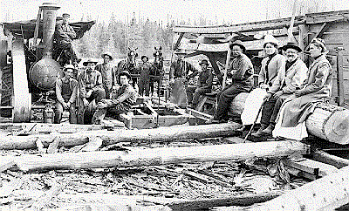
…A Slow Economy for Others
The economic boom did not reach the Maritimes, where the economy stayed the same or declined.

Slide 12
Reasons for this:
Shipbuilding, a major industry for the region, was in decline even before the First World War. No new major industry came to replace shipbuilding, and the regions were unable to modernize, keep up with new technologies, like other areas of Canada.

Slide 13
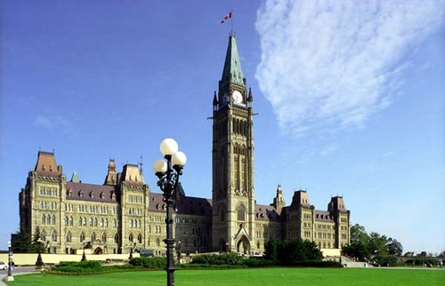
More Reasons for this:
There were federal policies (Canadian policies) brought in after the First World War that harmed the region’s economy:

Slide 14
Federal Policies: Increased Freights Rates
Increased freight rates, forcing manufacturers to raise costs. Higher prices made products less desirable and therefore customers lost interest.
Between 1920 and 1926, the region lost 42% of its manufacturing jobs.
Many people moved out of the Maritimes to find work in Central Canada and the United States.

Slide 15
Because the Maritimes had less money, hydroelectricity was slower to develop.
The lack of electrical power meant that industries could not take advantage of new technologies, so secondary industries, such as pulp and paper, were much slower to develop.

Slide 16
Vocabulary
*Secondary industry: work in manufacturing; usually taking natural resources and making some out of it. For example, building houses, jewelry, furniture, clothing, etc.

Slide 17
During the 1920s, in the Maritimes, primary industries continued to be an important source of employment.
*Primary industry: extracting/taking resources from the earth; mining, fishing, forestry, and farming.

