Slide 1
Canadian Sports and Leisure
Of the 1920s

Slide 2
Leisure
Inventions of radio and motion pictures changed the way people spent their free time.
Radios were a means to make a much greater variety of information and entertainment available to a wider audience.
http://archives.cbc.ca/arts_entertainment/media/topics/1631/

Slide 3
Leisure
Silent movies were a popular form of entertainment.
http://www.youtube.com/watch?v=JF38g4z_l_4&feature=related

Slide 4
Sports
The 1920s have been called Canada’s Golden Age of Sports.
With shorter work hours and more money to spend, Canadians began to attend more sporting events such as baseball, football and boxing.

Slide 5
Sports
Hockey games could be heard on the radio.
http://www.histori.ca/minutes/minute.do?id=14272
Racing, rowing and swimming were also very popular.

Slide 6
Women & Sports
Women began to take part in organized sports. In 1928, women were able to compete in track and field in the Olympics for the first time.
http://www.histori.ca/minutes/minute.do?id=14297
Women’s basketball gained more recognition.

Slide 7
Women & Sports
However, rules and regulations for women’s sports were often different from men’s. It was considered unhealthy for women to exert themselves as much as men.

Slide 8
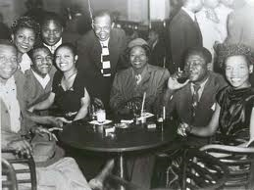
Changing and Conflicting Attitudes
Nightclubs became popular: people could relax, dance, smoke,
drink and listen to
live entertainment.
There were people
who objected/were
against these new
activities and attitudes.

Slide 9
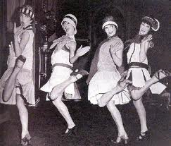
The flappers were one group many considered offensive. These were young women who seemed to take pleasure
in rebelling, and going to
nightclubs and dancing
the latest dances.
Many thought it was scandalous that these
women were doing activities traditionally done
by men, especially drinking and smoking.

Slide 10
Fashion
In women’s fashion, hemlines went up, hair styles were short, reflecting a new freedom for women.
In men’s fashion, pants went baggier with hats and bowties.
Such trends could only be afforded by the wealthier members of society.

