Slide 1
Acrostic Poems
Examples

Slide 2
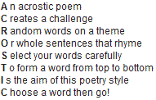

Slide 5
