Slide 1
Building Landforms
Our Country

Slide 2
Definitions
Core: The innermost layer of the earth’s interior.
Crust: The solid outer layer of the earth.
Magma: Molten rock within the earth.

Slide 3
Definitions
Mantle: The middle layer of the earth, between the crust and the core.
Elevation: The height measured from mean sea level.

Slide 4
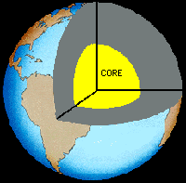
Label the layers of the Earth’s atmosphere
The earth has three main levels.
CRUST
MANTLE
CORE
Beneath the mantle is the Earth's core. The Earth's core consists of a fluid outer core and a solid inner core. Because the outer core contains iron, when it flows it generates a magnetic field. This is the source of the Earth's magnetic field.

Slide 5
Explain continental drift:
The earth’s crust is divided into a number of plates (sections) that move because of slow-moving convection currents in the mantle.

Slide 6
What are landforms?
Landforms are the topography (the natural features) of the land’s surface. This includes mountains, lakes, deserts, cliffs, tundra and so on.

Slide 7
What is landscape?
A landscape is an area’s landforms together with its cover of vegetation, water, ice, and rock. It also includes the activities of humans and other animals.

Slide 8
How are mountains formed by magma?
Formed when molten rock (magma) deep within the earth, erupts, and piles upon the surface. Magma is called lava when it breaks through the earth's crust. When the ash and lava cools, it builds a cone of rock. Rock and lava pile up, layer on top of layer.

Slide 9
How are fold mountains formed?
They are formed when two plates collide head on, and their edges crumbled, much the same way as a piece of paper folds when pushed together.
Most common type of mountain.
The North American Rockies

Slide 10
Fault mountains
Form when faults or cracks in the earth's crust force some materials or blocks of rock up and others down.
Sierra Nevada mountains in North America

Slide 11
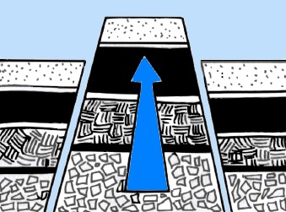
Fault mountains

Slide 12
http://magma.nationalgeographic.com/ngexplorer/0303/quickflicks/

