Slide 1
Canada at home

Slide 2
Key Terms
Rationing

Slide 3
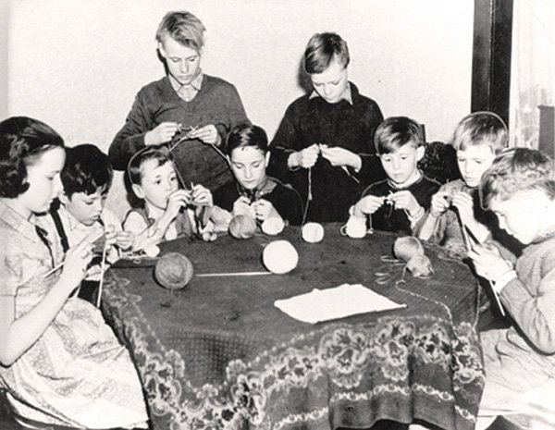
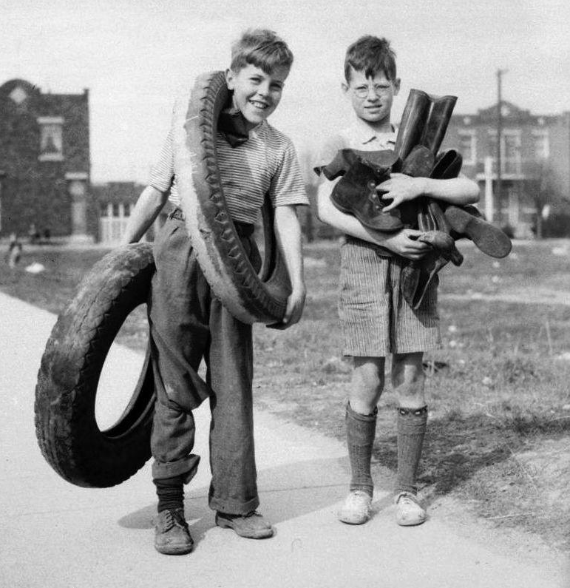
Scraping and Saving
Canadians did not just help out in the
battles, but at home.
Wartime Prices and Trade Board
(WPTB): controlled rationing of meat,
butter, oil, gas, and other scarce goods.
Children: Purchased war saving stamps (.25 each;
after saving $4 worth of stamps, they would
receive $5 back)
Collected cooking fat, milkweed, and bones;
their parents planted gardens, gave old pots/
pans to melt to create weaponry, and old
rubber to make tires.

Slide 4
The War At Home
The media was taken over by news from the war: radio, newspapers, magazines, movie houses.
Community and religious groups knitted warm clothes, collected books and newspapers, baked treats for those fighting.
German submarines were sinking ships off the east coast, putting coastal communities on alert.
1 in 10 enlisted; virtually everyone was directly affected/involved

Slide 5
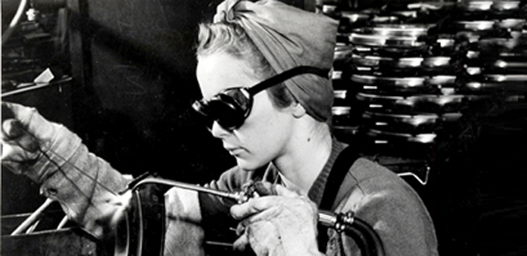
Women At War
Factories converted to
making wartime goods.
Women now working in the
factories – 570 000 at the beginning to over 1 million by 1944.
Elsie McGill: https://www.youtube.com/watch?v=WZoulEgf348
Women were expected to fill the roles of men in the workplace, volunteering for the war effort in their community - all while still maintaining their traditional roles at home.
Women also gave blood and bought war bonds.

Slide 6
Women’s Organizations
Made quilts, bandages and clothing.
Sent books, newspapers, and special treats to military hospitals overseas
Held “send-off” and “welcome home” parties for servicemen
Created canning clubs and recipes that adapted for wartime shortages

Slide 7
Sources
http://www.thecanadianencyclopedia.ca/en/article/wartime-home-front/
http://www.warmuseum.ca/cwm/exhibitions/newspapers/canadawar/homefront_e.shtml
http://www.veterans.gc.ca/eng/remembrance/those-who-served/women-and-war/homefront

Slide 8
Help At Home!
You must create a propaganda poster to encourage Canadians to help out with the war effort at home during World War II.
Include MULTIPLE ways your audience could help with the war effort and be specific – use full sentences to describe how one could help.
Must have a title and at least one large appropriate image, or multiple small ones.

Slide 9
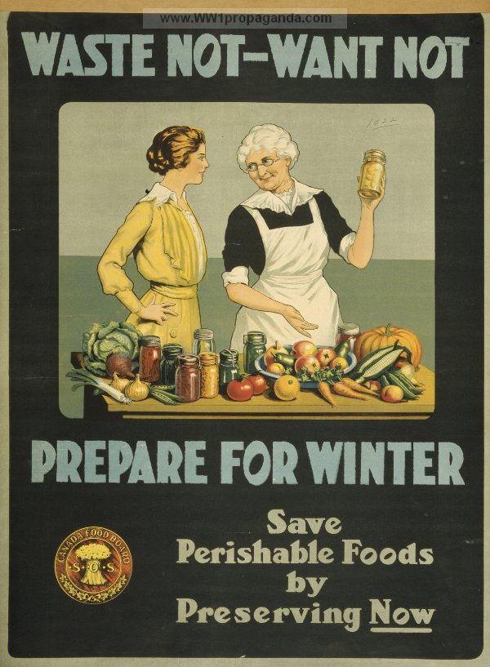
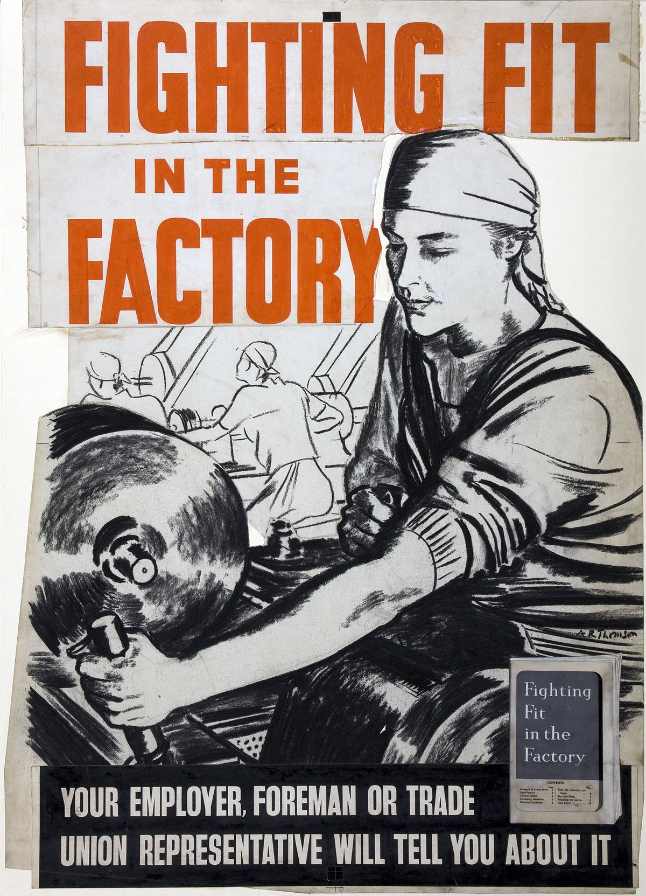

Slide 10
