Slide 1
Canada’s National Policy and Settling the West
Source: http://www.cbc.ca/history/SECTIONSE1EP10CH1LE.html

Slide 2
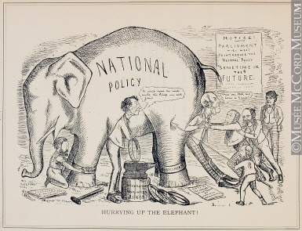
National Policy
Confederation: July 1, 1867
By 1873, country is in a major depression
Macdonald proposed the National Policy: raise taxes (tariffs) on certain goods coming into Canada from America

Slide 3
Looking West
Canada's western frontier was a massive, sparsely settled territory.
8 million km2 , which included parts of what are now northern Quebec, northern Ontario, Nunavut and most of the Prairies.
Macdonald feared the Americans were eyeing the land for themselves.
The National Policy would expand Canada's economic development westward.

Slide 4
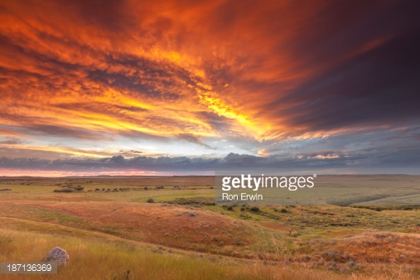
Wheat
Macdonald hoped the Canadian prairies would be the greatest wheat-growing region in the world.
Also wanted the unprocessed wheat to be shipped east where eastern manufacturers would process the grain to be shipped to England and the rest of the British Empire.

Slide 5
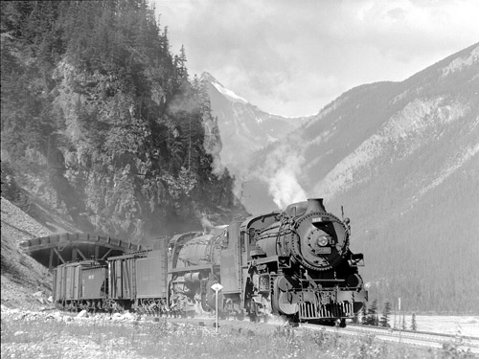
Railway
Macdonald wanted all machinery built in the East
What was needed to ship the wheat East, and the machinery West? A railway from one end of the country to the other.
Immigration ….

