Slide 1
Lucy Maude Montgomery
Other popular works based on her literature:
Emily of New Moon
Road To Avonlea
https://www.youtube.com/watch?v=sRnbt4Zn6i0
Anne of Green Gables has become a cultural icon (symbol) around the world, creating a big tourism industry for the island.

Slide 2
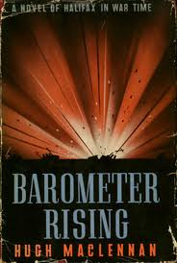
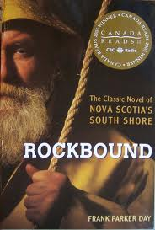
Other Authors
No Great Mischief by Alistair MacLeod
The Mountain and the Valley by Ernest Buckler
Fall on Your Knees by Ann-Marie MacDonald
Barometer Rising by Hugh MacLennan
The Birth House by Ami McKay
Rockbound by Frank Parker Day

Slide 3
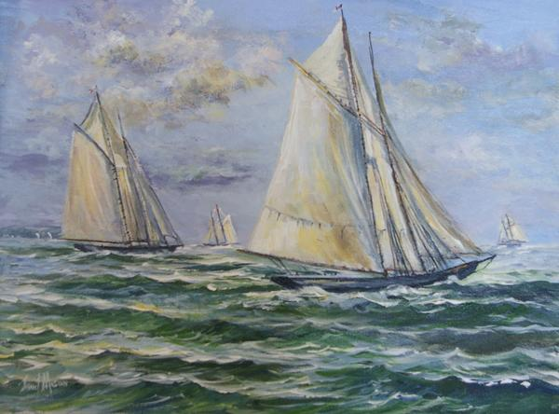
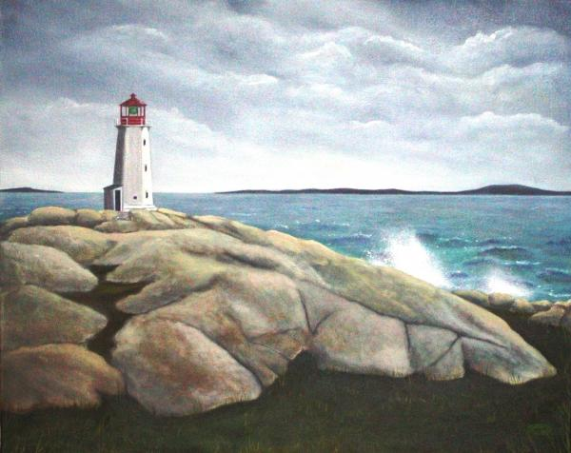
Atlantic Canadian Art
Artists of Atlantic Canada have often painted the dramatic landscapes of the area.

Slide 4
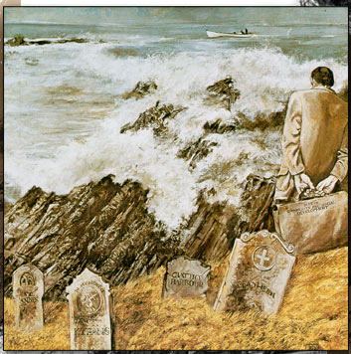
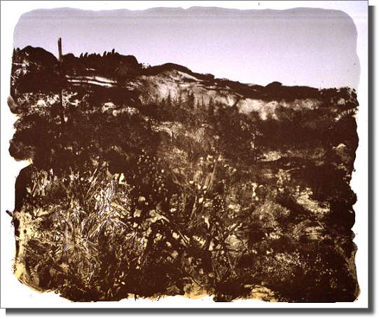
Gerald Squires

Slide 5
Maud Lewis

Slide 6
Maud Lewis (1903-1970)
born with almost no chin and was always much smaller than everyone else.
Maud's mother started her painting Christmas cards to sell and thus her career as an artist began.
Because of Maud’s worsening rheumatoid arthritis, she was unable to do housework. Her husband took care of the house, and Maud brought in money through her paintings.

Slide 7
Maud Lewis
The home they lived in was tiny in size and lacked things such as indoor plumbing and electricity, the house shows that Maud's life was full of enjoyment through her art.
Those who stopped after seeing her roadside sign, "Paintings for sale", found a quiet woman with a delightful smile. Her pleasure didn't come from the pride of having done a painting, but the creative act itself and the enjoyment others seemed to get from her work.

Slide 8
Through newspaper and magazine articles, as well as television documentaries, Maud became well known and a reputation grew that’s still growing today.

Slide 9
Maud Lewis
Today, Maud Lewis’ paintings sell for thousands of dollars.

Slide 10
Canada and Sports
Canadian sports is influenced by a number of factors:
Our four seasons, and our geographic and social diversity.
IE.: lacrosse (national summer sport) has been played by Aboriginal peoples for almost a thousand years. Hockey (national winter sport) was invented in Canada in the 1800s, and basketball was invented by Canadian Dr. James Naismith in 1891 to condition young athletes during the winter.
Today, soccer is the most popular sport among Canadian children. Do you agree?

Slide 11
Time for a ….. SPORTS MONTAGE
https://www.youtube.com/watch?v=s-h_OYk2aPc (35 secs)
https://www.youtube.com/watch?v=CO2omjEBxEw
https://www.youtube.com/watch?v=gSpXIxMk-zE
What do these videos say about Canada’s values (what we find important)?

