Slide 1
Challenges and Opportunities
Grade 8 Social Studies

Slide 2
Canada’s Population
An ageing population will put pressure on pensions & health care but stimulate growth as entertainment & leisure industries compete to serve the aged.
At the same time, an ageing pop. means a declining birth rate and calls into question the ability of Canada’s pop. To sustain itself.

Slide 3
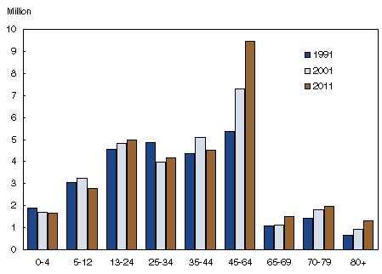
Population, selected age segments, Canada, 1991, 2001 and 2011

Slide 4
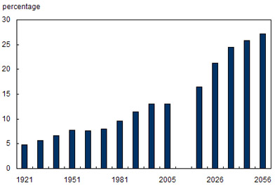
Percentage of Canadian population of persons aged 65 or older, 1921 to 2005 and projections to 2056

Slide 5
Compare services needed for ages 70+ and age group 20-29
Age Group 20-29 | Services Needed | Age Group 70+
 | Housing
 | Health
 | Recreation
 | Education
It is important for social and economic planners to have information about population structures because….

Slide 6
Why is population growth important?
Stat Canada predicts that by 2030 more people will die than be born = pop. decline.
Birth rate – the number of births each year per thousand of the population.
Canada’s current birth rate is 11.
1921, it was 29
1951, it was 27

Slide 7
Death Rate
Death rate – the number of deaths each year per thousand.
Canada’s death rate is 7.
1921, it was 12.
1959, it was 8.
A declining death rate increases the population.

Slide 8
Immigration Vs. Emigration
Net Migration – the difference between the number of people who immigrate to Canada (come to Canada) and the number of people who emigrate from Canada (leave).

Slide 9
Why Do We Need All Of This Info?
Gov’ts need to know how much money they will collect from taxes to pay for goods and services for their citizens.
Town and city planners who need to decide what kind of health services, schools, and roads their community will require.

Slide 10
Why…?
Developers who want to know where to locate different types of housing.
Businesspeople who want to know whether there will be enough customers for their business.

Slide 11
Dependency Load
This is a term used by demographers to describe the situation in which the income taxes paid by someone of working age are needed to support dependent members of society.
Retired people pay less income tax, but require more specialized services.

