Slide 1
Diamond Poems
Also known as Diamante Poems

Slide 2
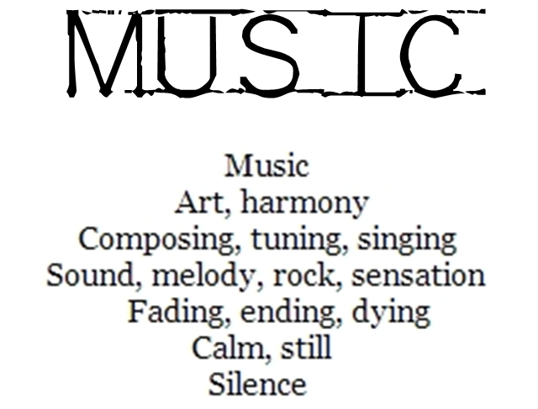
What is this “Diamond Poem” you speak of?
A diamond poem gets its name from its shape.

Slide 3
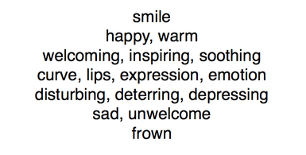
Format
What do you notice about the format of a diamond poem?

Slide 4
How To
Line 1 - subject of your poem.
Any subject, but you will be writing the opposite of this subject, so pick a subject for which you can think of an opposite.
Line 2 - two adjectives that describe your subject.
Line 3 - three actions that you associate with your subject, verbsthat end in -ing (like swaying or singing).
Line 4 - four things you associate with your subject → nouns.
Line 5 - three verbs that show there is a change place in your subject. (Don't use the same verbs you used in three.)
Line 6 - two words that describe the subject now that it is changed.
Line 7 - a word that is the opposite of your original subject-- the exact opposite of the word in line 1.

Slide 5
Example
Summer
Golden, fragrant,
Budding, blooming, bursting,
warmth, flowers , youth , colors
Fading, chilling, shrinking
Pale, dead
Winter

