Slide 1
Every Day Life in British North America
Political Empowerment
7.3.1 evaluate the conditions of everyday life for diverse peoples living in British North America in the mid-1800s

Slide 2
Each group and each person had their own version of “daily life,” depending on their place in society, gender, age, where they came from, and so on. So, for example, a 32 year old Acadian woman’s daily life would look much different than that of a 45 year old male Black Loyalist’s.
Can you guess how this might look different based on what we have learned about the two groups?

Slide 3
Homes
People’s homes (and what was in them) depended on what they were able to afford and where they lived – a town or in the country.
The rich who lived in towns had large, beautiful homes.
Farmers lived in the country, often in a one room log house with a dirt floor.
The Aboriginal still built traditional homes, so that depended upon the group and available resources.

Slide 4
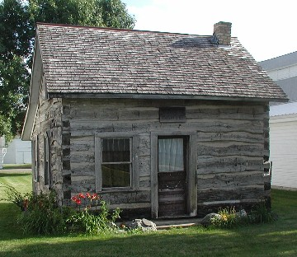
Homes
All homes had the following
in common:
Light from oil lamps (no electricity!)
Heat from wood stoves and fireplaces
No indoor plumbing (outhouses and
drinking from streams!)

Slide 5
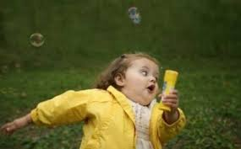
Transportation
Travelling by river was the best way to get
around – why?
Roads were very rough in these days. Think: No pavement, or even gravel, or graters to smooth out holes.
People travelled land by foot, horse or oxen
Potholes, stumps and deep mud made travel very difficult and often dangerous.
Railway still not efficient enough to use regularly.

Slide 6
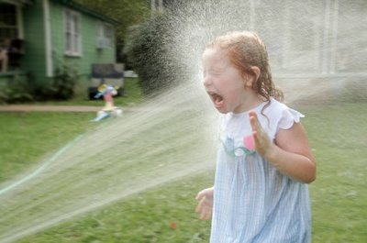
Health Care
People did not live as well or as long as they do today.
No vaccines for children = measles, scarlet fever, whooping cough
“Clean drinking water” was not a priority as people did not understand its importance, leading to epidemics.

Slide 7
Health Care
Health care was basically home remedies by a family member; doctors were minimal.
Those living in rural areas had virtually no health care or access to doctors.

Slide 8
Education
Most would strive to take a trade or continue the family business.
School = generally unimportant, though many knew how to read and write via
family members.
Reading, a favourite pastime.
Most schools run by religious organizations.

Slide 9
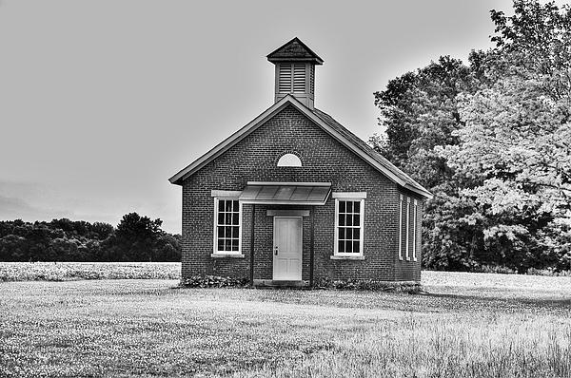
Education
Eventually public schools came to be (school paid for with taxes), open to all children.
Rarely open to children of minorities; religious groups set up separate schools for Aboriginal children.
Rural schools
the one-room school-
house.

