Slide 1
Heritage Fair

Slide 2
Display Tips:
We will supply all students with a display board!
Think about the volume of space available for the display, not just the flat display surface. (Table surface)
Use props, such as boxes or cans to give different heights and interest to displayed objects.

Slide 3
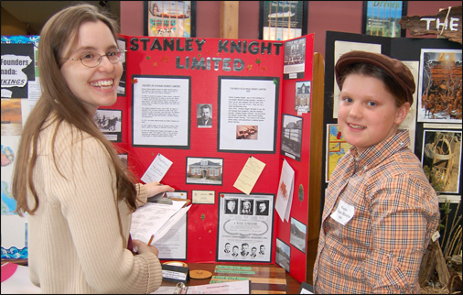

Slide 4
Projects must have display backboards
that do not exceed 100 centimetres (39.37 inches) high by 150 centimetres (59.06 inches) wide by 80 centimetres (31.5 inches) deep.
Students must understand that their exhibit needs to be:
• well-researched
• historically accurate
• educational
• clear and organized
• visually appealing
• free of clutter and confusion
• lightweight, portable and freestanding

Slide 5
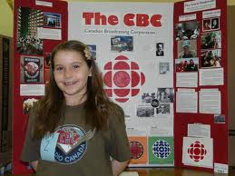

Slide 6
The research paper is the your record of work done to prepare the exhibit.
Here is what the student should include:
• title page
• name, grade and school
• research questions
• table of contents
• written and visual information
• graphs, tables, and charts
• glossary (if necessary)
• bibliography and acknowledgements
• topic conclusion and interpretation

Slide 7
One page “personal reflection” which addresses three important learning attributes:
What has the student learned?
How has the student’s project skills applied to his/her daily life?
Why is the topic still important in today’s world?

Slide 8
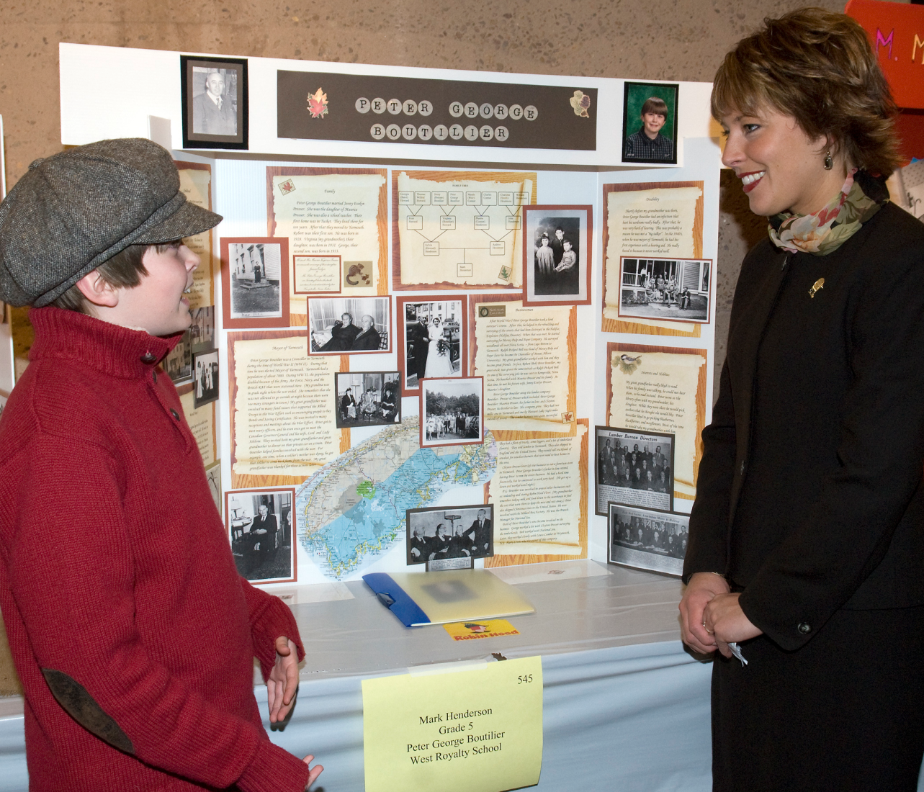

Slide 9
Some elements of an effective exhibit:
Orientation:
• title and subtitle of the topic are prominent
• place the topic title in the centre panel
• make the main idea clear to the viewer
Segmentation:
• use a timeline to organize a chronology of the topic
• organize the exhibit into subtopics
• compare, contrast, explain related detail on side panels
• place assorted sized boxes on the display table to showcase important props and artifacts.

Slide 10
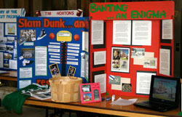

Slide 11
More Elements
Explanation:
• include at least three appropriate visuals
• visuals can be computer-generated, hand-drawn, photographs or cut outs
• materials enhance displays and must be labelled and described:
• artifacts (make sure students get permission and handle them with care!)
• posters

Slide 12
You can you use:
• crafts
• maps, dioramas and diagrams
• artistic displays
• collections
• caricatures
• models, props, costumes and food
• demonstrations
• photography
• short stories
• interviews
• diary entries
• research material

Slide 13
Advice:
make labels on a computer to guide viewers through the exhibit
use regular fonts with body text – it’s easier to read & understand
make captions stand out by using lettering placed on lighter coloured paper
avoid fancy typefaces that are hard to read unless their design reflects the topic
keep readability in mind and limit use of bold, italics, fancy fonts or coloured type
over-designing your exhibit can draw attention away from your message

Slide 14
Advice:
ensure the title is larger and stands out from captions.
use subheadlines to guide the viewer around the display.
keep captions concise so viewers can get the message quickly.
introduce and attract the viewer’s interest with the main title.
break down the topic into smaller parts with subtitles.
use common language and avoid jargon words that many people will not understand.
sentences that average 10 to 15 words are easier to read than excessively short or long sentences.
always use a ruler for straight lines and hand-lettering.

Slide 15
Advice:
arrange content logically using:
    headlines – about 5 to 7 words of letters two or three inches high (144 to 216 points)
• subheads – 12 to 15 words with letters about 1/3 as high as headlines (48 to 60 points)
• story labels – 150 words of easy-to- read sentences

Slide 16
http://resource.canadashistory.ca/fairs/
http://www.canadashistory.ca/Education/Heritage-Fairs/Stamp-Stories.aspx

