Slide 1
Japanese Internment
Canada

Slide 2
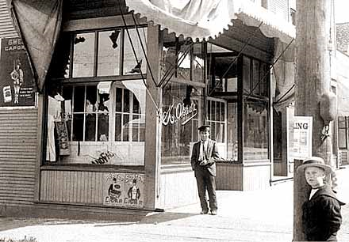
Grocery store owned by K. Odaka, ravaged by protesters during anti-Asian protests, 1907

Slide 3
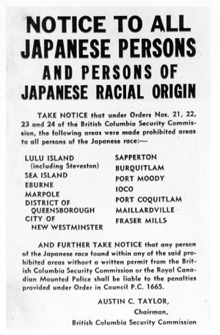
Japanese Internment
After the attack on Pearl Harbor, December 7, 1941, a racist campaign was launched against Japanese citizens living in North America, particularly ones residing on the Pacific Coast.
This included Japanese living in British Columbia.

Slide 4
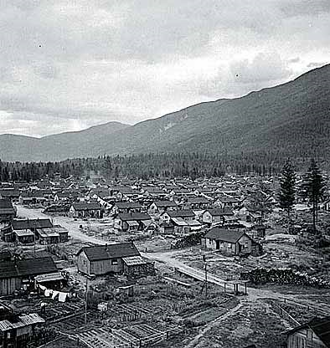
British Columbia
Internment camp for Japanese citizens

Slide 5
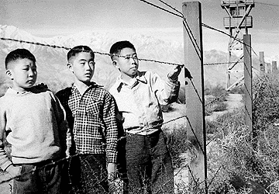
Japanese Internment
Three young children stand by a barbed wire fence of an Internment camp, which surrounded their entire living area.

