Slide 1
Latitude & Elevation
Grade 8 Social Studies

Slide 2
What is Latitude?
EQUATOR – an imaginary line that divides the Earth into 2 equal parts (Northern & Southern hemispheres)
• Are imaginary lines
• The Equator is the starting point for latitude lines
• Measure the distance North & South of the Equator
• Lines are drawn around the Earth, parallel to the Equator
• Lines are used as political boundaries

Slide 3
Latitude & Temperature
The Equator is at 0° - do you know what kind of temperature countries around this area might be?
Look at the map on the next slide – How do you think latitude might relate to temperature?
Think about the temperature at the Equator compared to the Arctic (90°)....

Slide 4
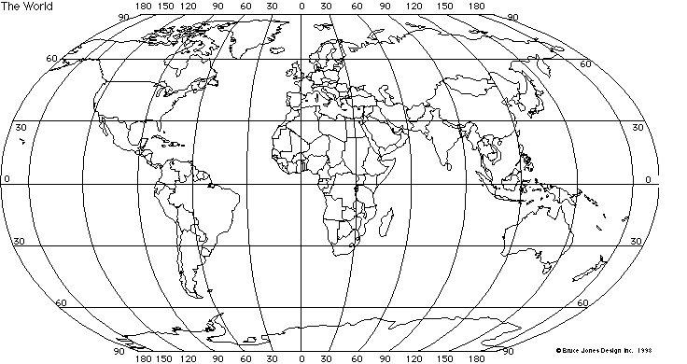
World Map

Slide 5
Elevation
Review the meaning of ELEVATION.
Recall how we learned that there is a LOWER ELEVATION at SEA LEVEL.
How might elevation affect temperature?

