Slide 1
Migration and Canada
Grade 8 Social Studies notes

Slide 2
Push Factors
Definition: why people want to leave their current location.
Examples:

Slide 3
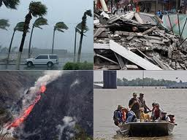
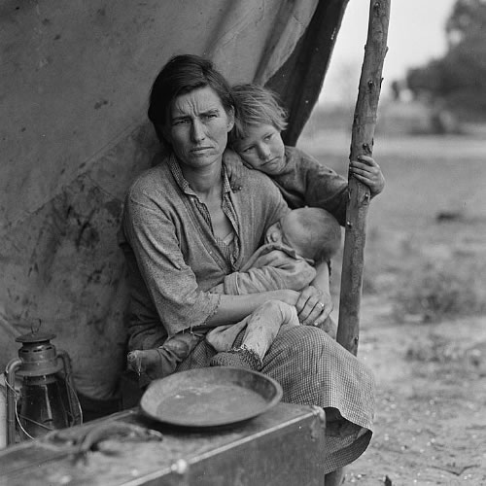
Other examples of Push Factors
Lack of political/religious freedom, war, famine, poverty, climate change, natural disasters, unemployment.

Slide 4
Pull Factors
Definition: attract people to a new place.
Examples:

Slide 5
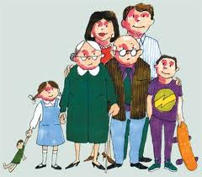
Other examples of Pull Factors
Jobs, land, family, better climate, resources, technology, government.

Slide 6
Changing Immigration Patterns
Canada’s reputation today: welcoming to immigrants (people from other countries).
Immigration policies (rules) depend on economic conditions and social and political attitudes.
The government controls these policies.

Slide 7
Multiculturalism
Definition: An official policy that recognizes and supports the traditions and identities of the many cultural groups living in Canada.
Canada promotes this acceptance of different cultures in our society today. But it was not always this way.... How?

Slide 8
In the past, Canadians were guilty of ethnocentrism, prejudice and discrimination.
Ethnocentrism: The idea that one’s own beliefs and values are superior to others.
Prejudice: The belief that not all people have equal people.
Discrimination: Unfair treatment based on race, language, religion, culture, or other factors.

Slide 9
Examples of racist immigration policies
Early 1900s: African-American farmers from the US were turned back at the border. Officials said they were not suited for our climate.
1923 : The Chinese Immigration Act forbade the entry of Chinese people in Canada.

Slide 10
Examples of racist immigration policies
1930s: Canada refused Jewish refugees fleeing Nazi Germany in the 1930s.
Some Jewish refugees who did make it to Canada during the Second World War were put into prison camps along with German prisoners of war.

