Slide 1
Moving Away from Conformity
Changing Styles

Slide 2
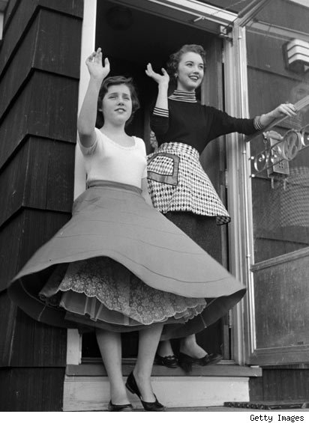
Women’s Fashion in the 1950s
Full-skirted dresses were a sign of prosperity after the war.
Wearing pants in public were frowned upon.

Slide 3
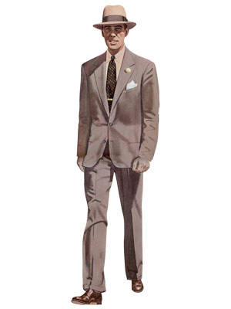
Men’s Fashion in the 1950s
Wide-legged, cuffed pants for men reflected post-war prosperity.
Suits and sports jackets and ties were expected of men working in businesses and offices.

Slide 4
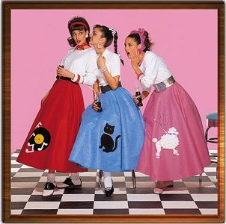
Girls in the 1950s
Clean-cut
Skirts (pleated or poodle), white blouses and sweaters, knee socks and ponytails.
Short, jeans and capris became popular later in the decade.

Slide 5
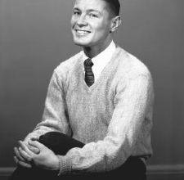
Boys in the 1950s
Clean-cut
Cotton pants, V-neck sweaters, and short, neat haircuts (crew cuts).

Slide 6
Rejecting Social Norms
Signs of rebelling against the conservative norms and values of society.
The “rockers and hoods” wore black T-shirts, jeans, and leather jackets.
Wore their hair longer and slick back: the “duck-tail.”
Women who rebelled wore pants.

