Slide 1
Poetry Devices

Slide 2
Poetic Devices in song
https://www.youtube.com/watch?v=eF0gyQ6V74Q

Slide 3
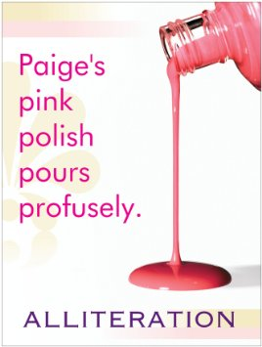
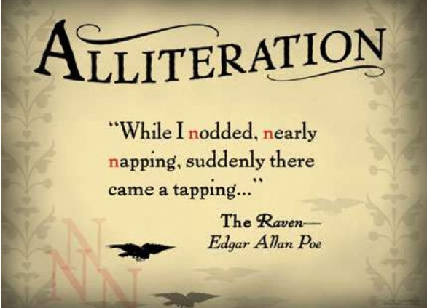
Alliteration
Definition: the repetition of a beginning sound.
Rain reigns roughly through the day.
She sells seashells by the seashore.

Slide 4
Allusion
Definition: a reference to someone or something in history or literature that creates a mental picture.
Examples:
Christy didn't like to spend money. She was no Scrooge, but she seldom purchased anything except the bare necessities.
Little did I know That you were Romeo, you were throwing pebbles, And my daddy said, "Stay away from Juliet.“
~ T. Swift

Slide 5
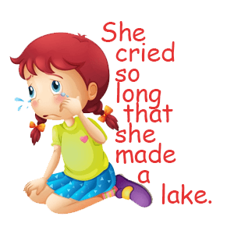
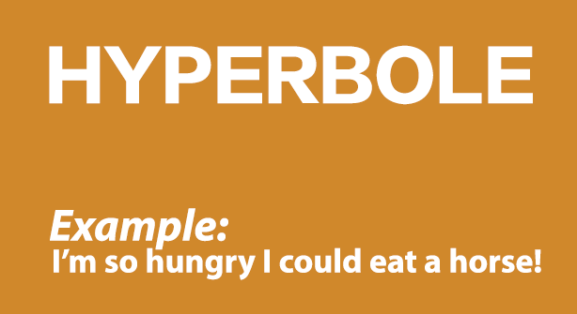
Hyperbole
Definition: extreme exaggeration for effect.
Examples:
Emma’s book bag weighed a ton.

Slide 6
Metaphor
Definition: the comparison of two unlike things by saying one is the other.
Example:
Clouds are ships in full sail
Racing across the sky-blue sea.
Wind fills the cotton canvas
Pushing them further away from me.
Clouds are compared to ships.

Slide 7
Simile
Definition: the comparison of two unlike things by saying one is like or as the other.
Clouds are like ships in full sail Racing across the sky-blue sea. Wind fills the cotton canvas Pushing them further away from me.
Both metaphor and simile are comparisons of unlike things, but metaphor states one thing is the other while simile says one is like the other, or as the other.

Slide 8
Onomatopoeia
Definition: the sound a thing makes .
Roaring with the pain Caused by flashing lightning strikes, Thunders yells, "Booooom! Craaaashhhh! Yeow!" Then mumbles, rumbling on its way.
Grrrr, the lion's cry echoes Through the jungle's den Causing creatures small To scurry to their holes.
Boooom, craaaashhh, yeow, and grrrrr are examples of onomatapoeia.

Slide 9
Personification
Definition: the giving of human traits to non-human things incapable of having those traits.
I walk a lonely road The only one that I have ever known Don't know where it goes But it's only me, and I walk alone
I walk this empty street On the boulevard of broken dreams Where the city sleeps And I'm the only one, and I walk alone
Green Day, Boulevard of Broken Dreams

Slide 10
Symbol
Definition: something which represents something else besides itself.
The dove, with olive branch in beak, Glides over all the land Searching for a place to light. Storms of war linger on every hand, Everywhere the hawk does fight.
The dove is a symbol of peace, and the hawk is a symbol of war. Using them in poetry gives an image without having to explain in detail.

Slide 11
https://www.youtube.com/watch?v=vMSLgxj2dxk

