Slide 1
The Holocaust

Slide 2
Film Footage
http://www.ushmm.org/wlc/en/gallery_fi.php?ModuleId=10005143

Slide 3
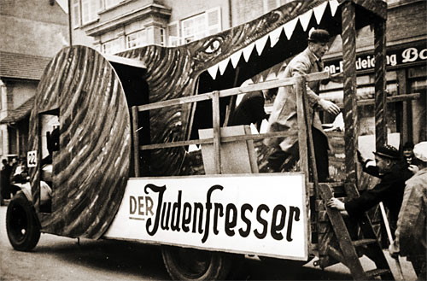
Anti-Jewish parade float
Public displays of antisemitism in Nazi Germany took a variety of forms, from posters and newspapers to films and radio addresses.
A float in a Shrove Tuesday parade features workers from the local aluminum cylinder works feeding "Jews” (wearing paper noses) to the "Jew Devourer," a voracious crocodile. The motto carried by the workers' unit in the parade (not shown) was: "Grumblers and Trouble-Makers go under the Roller."

Slide 4
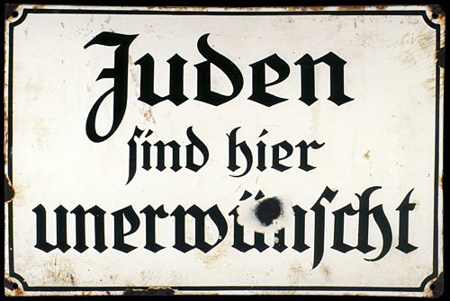
Antisemitic sign
Antisemitic sign reading, "Juden sind hier unerwunscht" (Jews Are Unwanted Here).

Slide 5

April 1933
Germans read a poster affixed to a pillar in a busy Berlin street warning them not to buy from Jews.

Slide 6
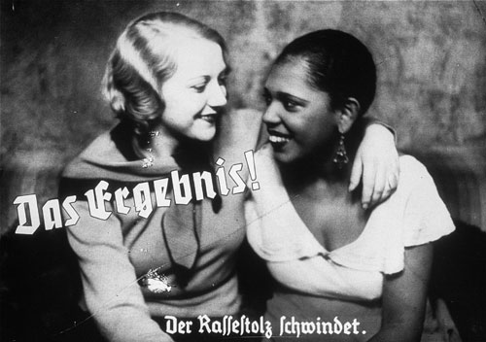
Propaganda slide depicting "loss of racial pride"
This propaganda slide depicts friendship between an Aryan woman and a black woman as a loss of racial pride. The caption says: "The experience/ Racial pride fades." Germany, ca. 1933-1939.

Slide 7
Kristallnacht: The Night of Broken Glass
a series of attacks against Jews throughout Nazi Germany and parts of Austria on November 9–10, 1938.
Jewish homes, shops, towns & villages were ransacked, as SA storm troopers & civilians destroyed buildings with sledgehammers, leaving the streets covered in pieces of smashed windows.

Slide 8
Kristallnacht
91 Jews were killed, and 30,000 Jewish men—a quarter of all Jewish men in Germany—were taken to concentration camps, where they were tortured for months, with over 1,000 of them dying. Around 1,668 synagogues were ransacked, and 267 set on fire. In Vienna alone 95 synagogues (houses of prayer) were destroyed.

Slide 9
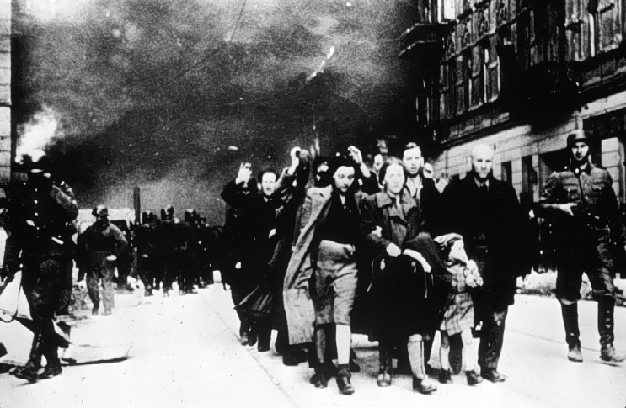
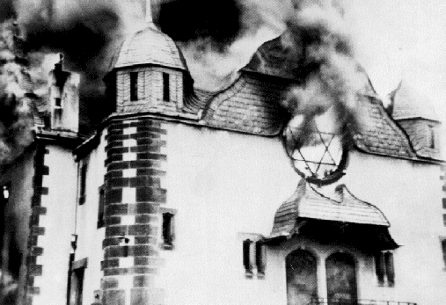
Photos of Kristallnacht

Slide 10

November 10, 1938
Local residents watch as the synagogue in Ober Ramstadt, Germany, is destroyed by fire. The local fire department tries to prevent the fire from spreading to a nearby home.

Slide 11
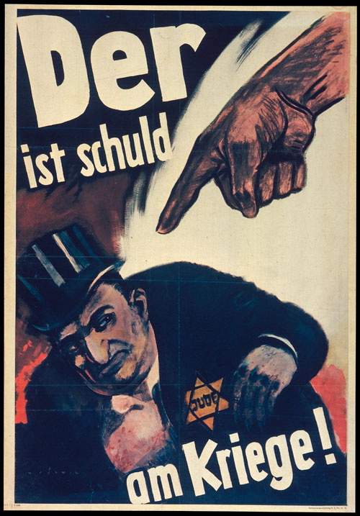
Poster: "He is guilty for the war"
1943 anti-Jewish poster by the artist "Mjolnir" intended to persuade Germans that Jews were responsible for starting the war. "Mjolnir" was the pen name of the artist Hans Schweitzer who created many of the most popular Nazi propaganda posters.

Slide 12

1940–1944
Mug shot of prisoner accused of homosexuality in Auschwitz concentration camp.

Slide 13
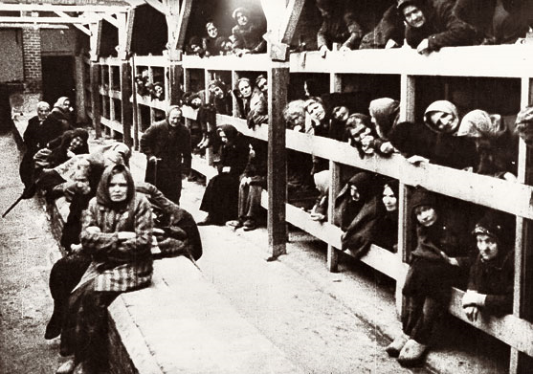
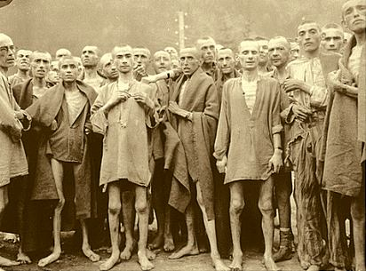
Auschwitz Concentration Camp
The photos below were taken at Auschwitz Concentration Camp – These are the real faces of people of the Holocaust.

