Slide 1
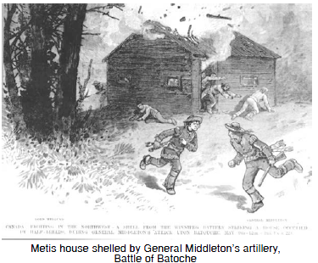
The Northwest Rebellions
Cultural Empowerment

Slide 2
Troubles in Saskatchewan
Issues from Macdonald’s National Policy
Settlers: costs of shipping and supplies were high; route of the railway; how land was given out; little representation in the government (Members of Parliament)
Metis: After Red River, moved to Saskatchewan; slow to be given land – poor land when it did happen; treaties/rights not being respected.

Slide 3
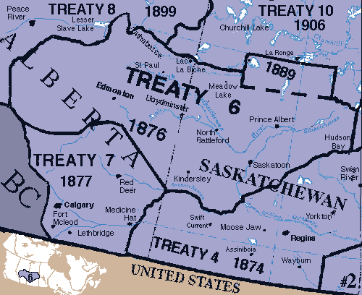
Issues from Macdonald’s National Policy Continued
First Nations: disappearance of buffalo + European settlement = loss of traditional ways.
Treaty 6 signed in 1876, not being upheld → food and other supplies
not being provided,
communities facing
starvation.

Slide 4
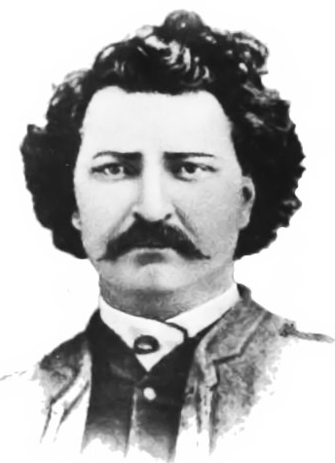
The Return of Riel
1884 – Louis Riel was invited to come back and help, hoping he could back a difference as he had with the Northwest Rebellion.
Drew up a petition lobbying for changes, given to the Macdonald government.
Asked for treaties to be honoured (First Nations), change in economic policies (settlers), land rights protected (Metis).
When little resulted, Riel formed
the Provisional Government of
Saskatchewan and threatened to
take control by force.

Slide 5
Next Move?
Riel actually lost the support of many he was trying to help when he decided to fight. They believed he had not given the gov’t enough time to react.
Only the support of two First Nations groups remained.

Slide 6
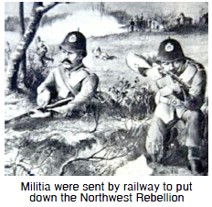
Reactions
Who fought on behalf of the government?
Northwest Mounted Police
A militia that Macdonald formed and sent West.
Following this, many events ensued, what we now refer to as the Northwest Rebellion, led by Louis Riel.
Louis Riel and his forces were put
down and Louis Riel was executed.
Video (start @ 4.15min in) https://www.youtube.com/watch?v=t5YrtvO7FDs

Slide 7
Effects of the Rebellion
New settlers felt safer moving to the prairies.
First Nations had to “make due” on their reserves.
Metis communities and culture suffered.
The divide between French and English grew.

