Slide 1
The Regions of Canada

Slide 2
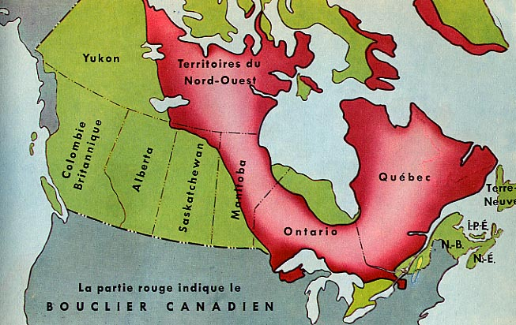
The Canadian Shield

Slide 3
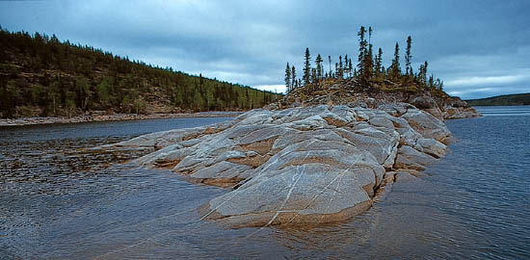
The Canadian Shield

Slide 4
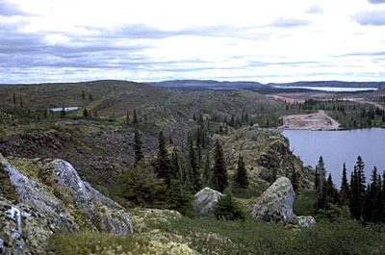
The Canadian Shield

Slide 5
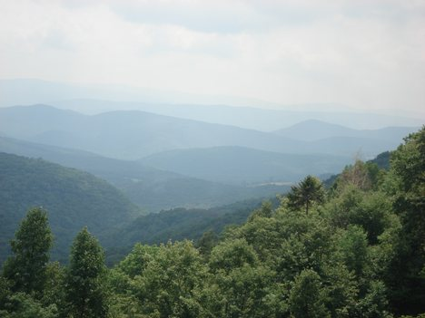
Appalachian Mountains

Slide 6
Appalachian Mountains

Slide 7
Appalachian Mountains

Slide 8
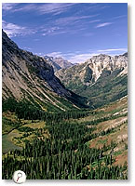
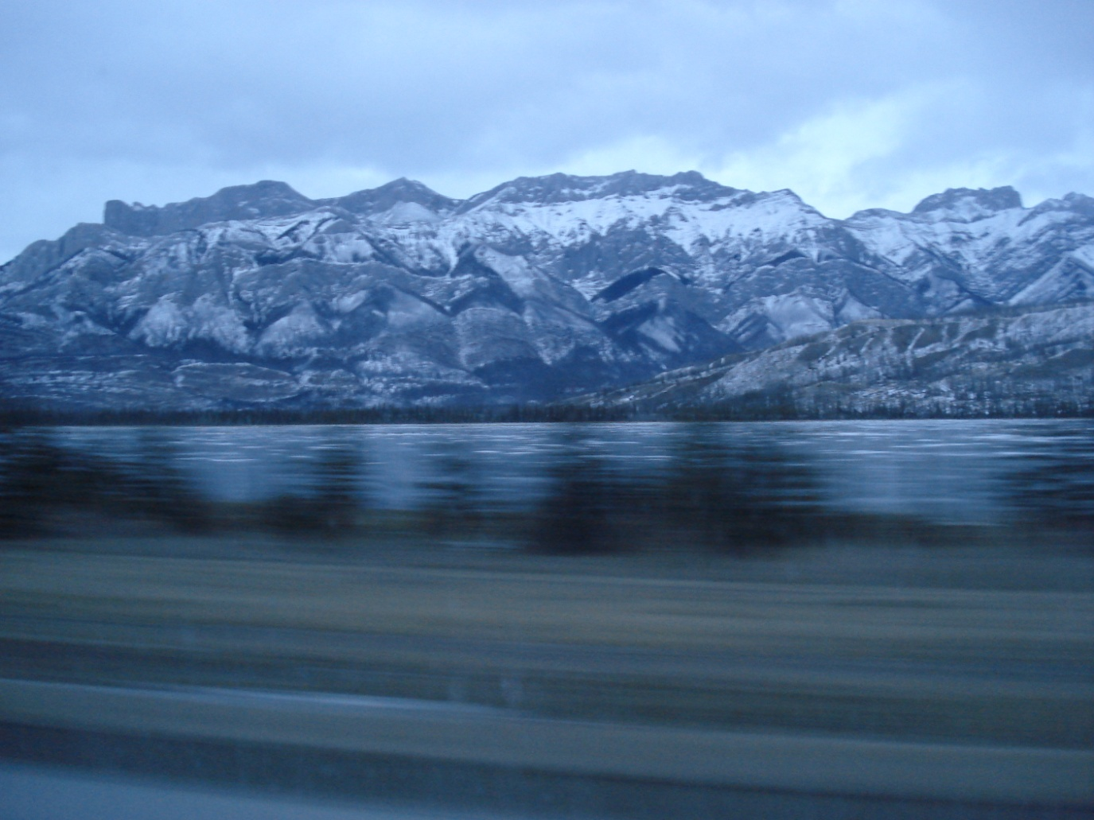
Western Cordillera

Slide 9
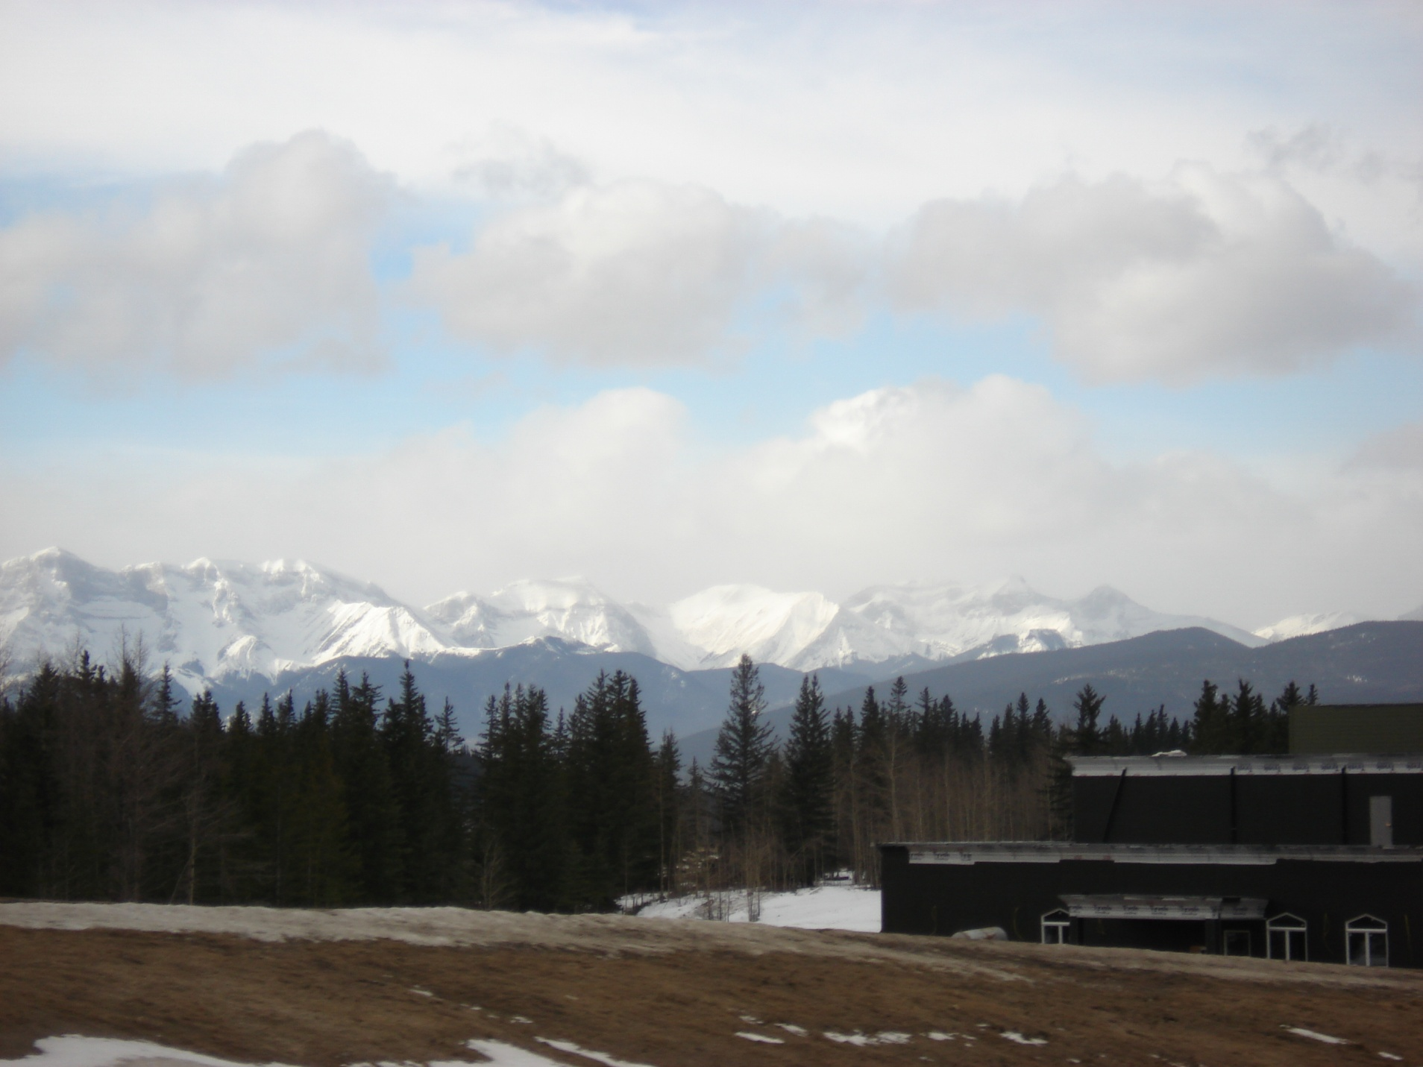

Slide 10
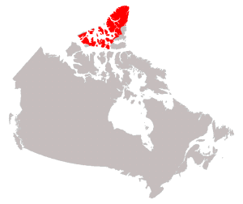
Innuitian Mountains

Slide 11
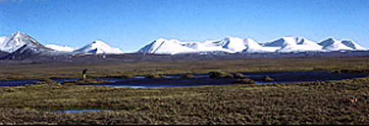
The Innuitian Mountains
Nunavut

Slide 12
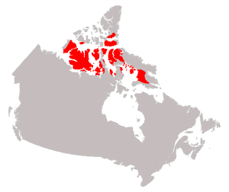
Arctic Lowlands

Slide 13
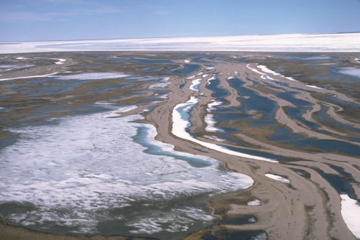
Arctic Lowlands

Slide 14
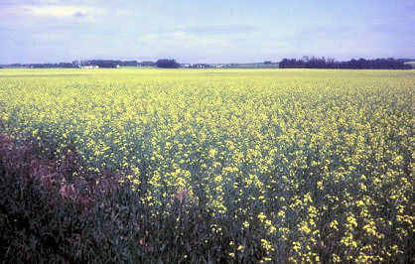
Interior plains

Slide 15
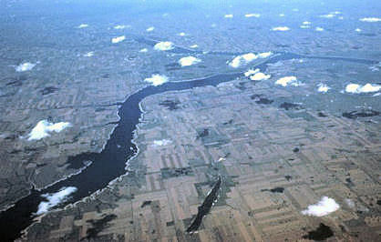
Interior plains

Slide 16
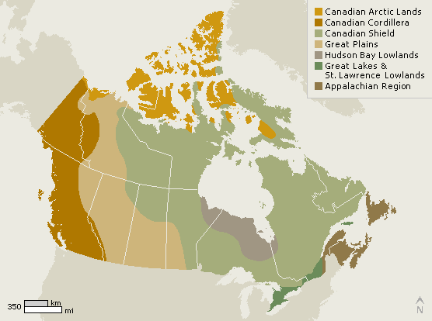
Great Lakes – St. Lawrence Lowlands

Slide 17
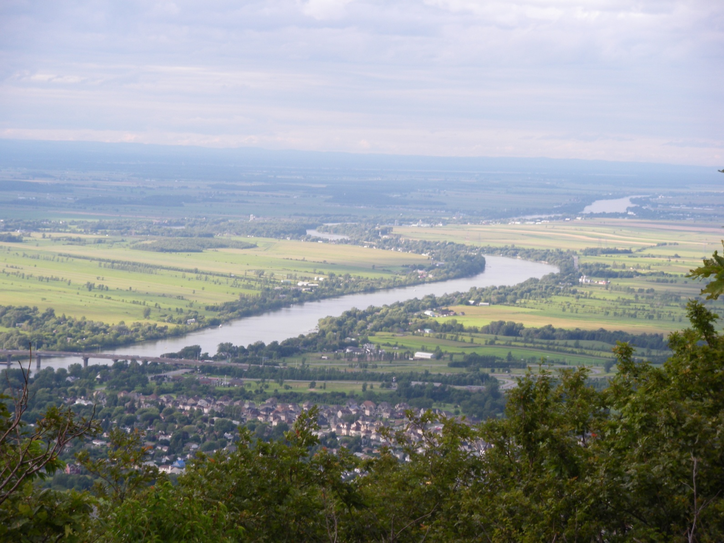
Great Lakes – St. Lawrence Lowlands

Slide 18
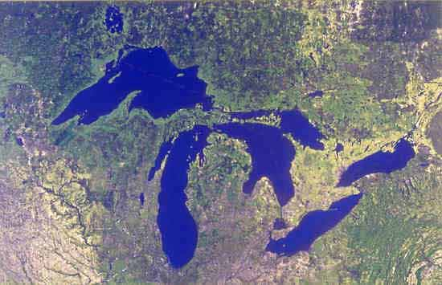
Great Lakes

Slide 19
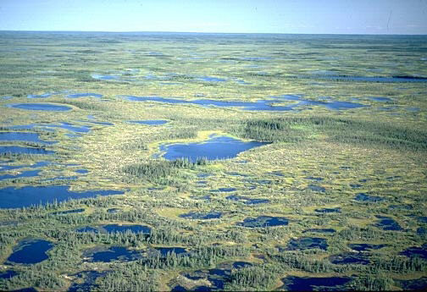
Hudson Bay Lowlands

Slide 20
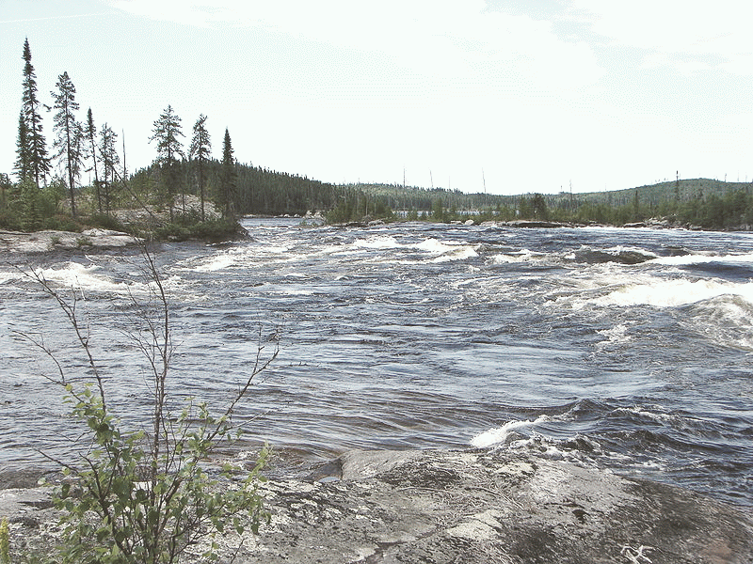
Hudson Bay Lowlands

