Slide 1
The Start of World War II
THE ROAD TO WAR

Slide 2
Key Terms
Fascism: A type of one-party government, led by one person, who makes all decisions for the whole country.
Opposite of democracy
Compare to Canada
https://www.youtube.com/watch?v=7CYUxLbl_PM
Dictator: A person who has complete control over a control; usually gets power by force, and rules by force.
Appeasement: Giving an aggressive person, group or organization what they want to avoid conflict.

Slide 3
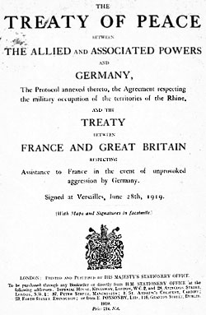
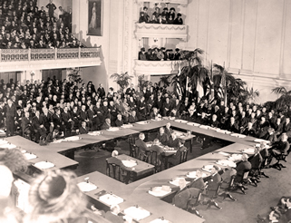
What Led to World War II
The Second World War in Europe was caused in large part by the Treaty of Versailles, the peace settlement which ended WWI. The Treaty had punished Germany severely, making them pay reparations to the victors and taking large sums of money.

Slide 4
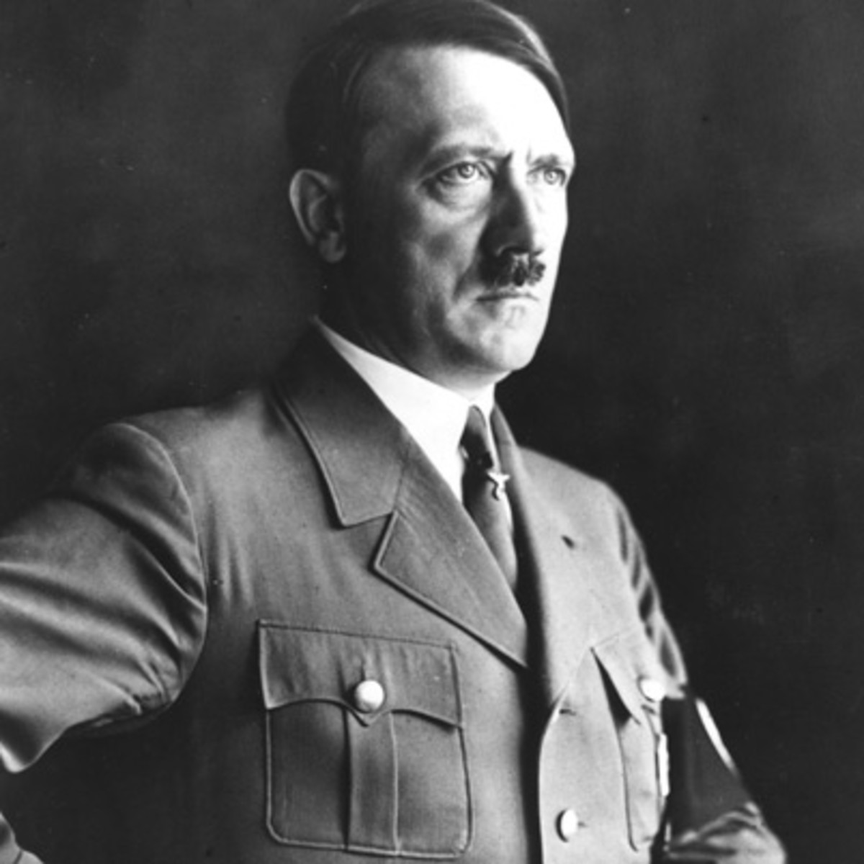
Hitler: A Dictator Born
Adolf Hitler and the Nationalist Socialist Party (Nazis) were elected to power in 1933. They used Germany’s anger over the Treaty of Versailles to become popular. Hitler promised that he would
tear up the treaty and bring
Germany back to greatness.
Once elected, Hitler outlawed
all other political parties other
than his own:
a dictator was born.

Slide 5
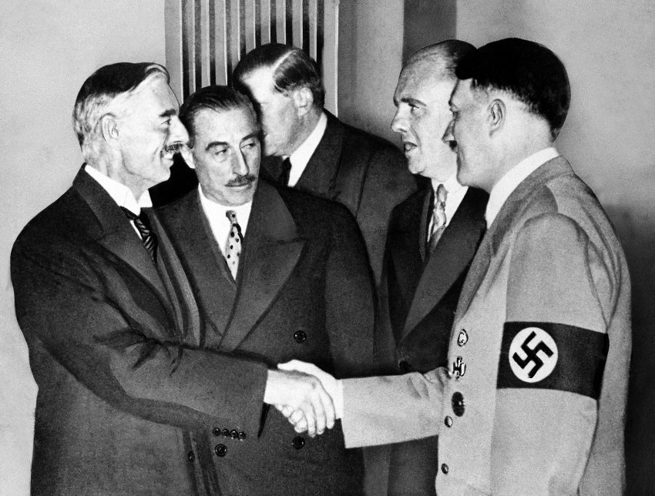
Appeasement
Once in power, Hitler began to break the terms of the Treaty of Versailles.
Built up Germany’s army
Reoccuped/annex territory that had been taken away from Germany after WWI.
No one took a stand against
these violations because no
One wanted to return to war
as it had only been 20 years
since WWI, the “war to end
all wars.”
APPEASEMENT

Slide 6
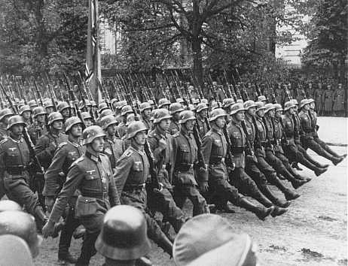
War Begins
Giving Germany what it wanted did not work out this way, as Hitler did not stop; he continued to demand more and more.
September 1, 1939, Germany invaded Poland – Poland had been given land in the WWI treaty Germany believed was theirs.
Had signed a pact in 1934, but this was to avoid conflict with their French allies
Britain and France were allies
of Poland; because of this, Britain
and France declared war on
Germany two days later.
Meanwhile, in Asia, Japan was
at war with China.

Slide 7
Canada At War?
Because it was part of the British Empire, when Britain declared war, Canada was at war as well (Britain’s allies were Canada’s allies, and when you go to war, your allies go to war with you).
During the First World War, the government had ordered Canadians to conscript, which had caused a crisis. Would this happen again?

Slide 8
Canada Officially Enters
Prime Minister William Lyon Mackenzie King decided that Canada would support Britain fully by providing war materials, and only a small volunteer army.
Canada formally declared war on Germany on September 10th, 1939.

Slide 9
Series of Events
March 1936: Rhineland occupied
March 1938: Austria annexed
October 1938: Sudetenland occupied
March 1939: Czechoslovakia occupied
September 1939: Poland invaded

Slide 10
