Slide 1
The War in the Pacific

Slide 2
Germany defeated!
D-Day was a success, the focus was now on Japan.
After the fall of Hong Kong, China, Canada focused its efforts on Europe.
May 1945, over 80 000 Canadian soldiers volunteered to join the war in the Pacific.
This was to never be because of the events of September 1945….

Slide 3
The Manhattan Project
US scientists were developing the newest technology in warfare, the atomic bomb.
July 1945 – the first successful testing took place.
It was a difficult choice to make, whether or not to use this bomb: MANY civilians would be killed.

Slide 4
The A-Bomb Debate
US President Harry Truman stated that the purpose of dropping the atomic bomb was to destroy the ability of Japanese to continue to wage war.
The Japanese were very good fighters who seemed to have no fear and never grow weary of fighting.

Slide 5
August 6, 1945
The first atomic bomb was dropped on Hiroshima, Japan: No surrender.
The second atomic bomb was dropped on Nagasaki three days later.
The two cities were devastated, immediate fatalities ranged from 100 000 to 140 000 (civilians). The same number would die later from radiation exposure.

Slide 6
Hiroshima, Day of Destruction
On the ground moments before the blast it was a calm and sunny Monday morning. An air raid alert from earlier that morning had been called off after only a solitary aircraft was seen (the weather plane), and by 8:15 the city was alive with activity -- soldiers doing their morning calisthenics, commuters on foot or on bicycles, groups of women and children working outside to clear firebreaks.

Slide 7
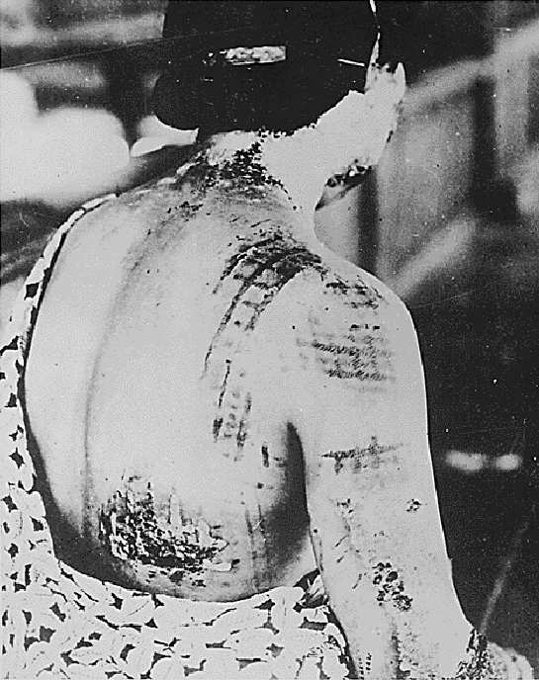
Those closest to the explosion died instantly, their bodies turned to black char. Nearby birds burst into flames in mid-air.
Paper instantly ignited as far away as 6,400 feet from ground zero.
The white light acted as a giant
flashbulb, burning the dark
patterns of clothing onto skin
(right) and the shadows of bodies
onto walls.

Slide 8
After Effects
About half of the city's population was dead or injured.
In those areas most seriously affected almost no one escaped serious injury. The numerous small fires that erupted all around the city soon merged into one large firestorm, creating extremely strong winds that blew towards the center of the fire.
The firestorm took up 4.4 square miles of the city, killing anyone who had not escaped in the first minutes after the attack.

Slide 9
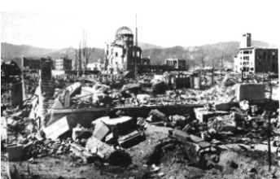
Confusion in Japan
For hours after the attack the Japanese government did not even know for sure what had happened.
Radio and telegraph communications with Hiroshima had suddenly ended at 8:16 a.m., and vague reports of some
sort of large explosion had
begun to filter in.

Slide 10
Another Threat
American’s threatened that if Japan did not surrender, another devastating bomb would be dropped; this time, on Nagasaki.
When the Soviet Union declared war on Japan on August 8th; hopes for Japan’s surrender were dashed.
By August 9th, American aircraft were showering leaflets all over Japan, informing its people that…

Slide 11
The Leaflet Read…
"We are in possession of the most destructive explosive ever devised by man. A single one of our newly developed atomic bombs is … the equivalent in explosive power to what 2,000 of our giant B-29s can carry on a single mission. This awful fact is one for you to ponder and we solemnly assure you it is grimly accurate. We have just begun to use this weapon against your homeland. If you still have any doubt, make inquiry as to what happened to Hiroshima when just one atomic bomb fell on that city."

Slide 12
An End
The first atomic bomb was dropped on Hiroshima, Japan: No surrender.
The second atomic bomb was dropped on Nagasaki three days later.
The day after the attack on Nagasaki, Japan surrendered.

