Slide 1
Why Confederation
A Closer Look

Slide 2
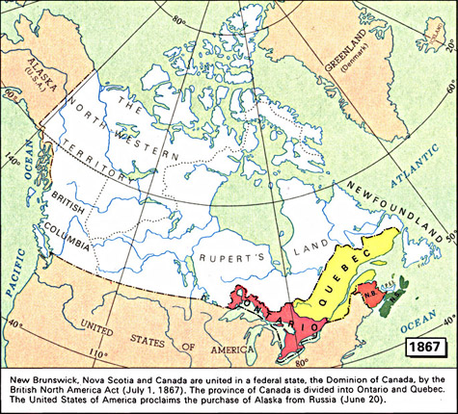
1867 ; some of the colonies want to join together = Confederation.
Province of Canada (East & West), NS, and NB
Who had yet
to join?

Slide 3
Two Choices
Would each colony have more economic and political power if it took charge of its own affairs?
OR
Would the colonies do best if they all worked together?
What do you think?

Slide 4
The Opinions
Nova Scotia & New Brunswick: the premiers, Tupper and Tilley were pro-confederation.
PEI: Not…. Sure….
Province of Canada: Uniting the English and the French (East & West, AKA Quebec and Ontario) into one was not going well.
Hoping if the joined Confederation, they could be separate from each other, but part of one, large political organization.
Newfoundland: not invited to Charlottetown Conference due to location and assumption of lack of interest. By the time they were invited, didn’t have time to select delegates and arrange transportation.

Slide 5
The Conferences
The Charlottetown Conference
https://www.youtube.com/watch?v=vBGNEJpznNE
The Quebec Conference and the Seventy-Two Resolutions:
All attended, including NFLD.
Formal decision by the group – the Seventy-Two Resolutions.
http://www.canadahistoryproject.ca/1867/#

Slide 6
WHY CONFEDERATION?
Threat from the US
Easier to protect as one, large entity
Trade
Reciprocity trade with the States ended, which hurt Canada’s economy
Could not depend on US any longer
Need for More Railways
Railways existed, but were not connected
Demand For More Land
More settlers, need for more land
CHOOSE ONE COLONY TO FOCUS ON AND COMPLETE ‘Debating Confederation’

